Slide 2
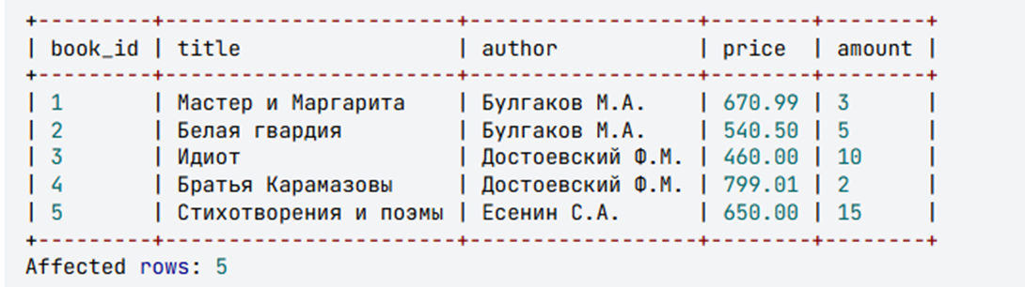
Selecting all data from a table
To select all data from a table, an SQL query of the following structure is used:
The keyword SELECT;
The symbol *;
The keyword FROM;
The table name.
The result is a table containing all the rows and columns of the specified table from the query.
Example
Select all records from the book table.
Query:
SELECT * FROM book;

Slide 3
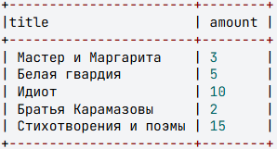
Selecting Specific Columns
To select data from specific columns of a table, an SQL query with the following structure is used:
The keyword SELECT;
A list of the table's column names, separated by commas;
The keyword FROM;
The table name.
The result is a table containing all the data from the columns specified after SELECT in the original table.
Example
Select the titles and quantities of books from the book table.
SELECT title, amount FROM book;

Slide 4
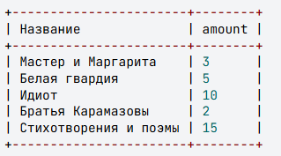
Assigning New Names to Columns in a Query Result
To select data from specific table columns and simultaneously assign them new names in the output, an SQL query with the following structure is used:
The keyword SELECT;
The column name;
The keyword AS;
The new column name for the query result (you can use Russian letters, but it must be a single word; if the name consists of two words, connect them with an underscore, e.g., Kolichestvo_knig);
A comma;
The next column name;
...
The keyword FROM;
The table name.
A single query can use both the original column names from the table and new assigned names.
The result is a table containing all the data from the columns specified after SELECT in the original table. Each column in the result is given the new name specified after AS, or it retains the original column name from the table if AS is omitted.
Example
Select all book titles and their quantities from the book table, assigning the column title the new name Название.

Slide 5
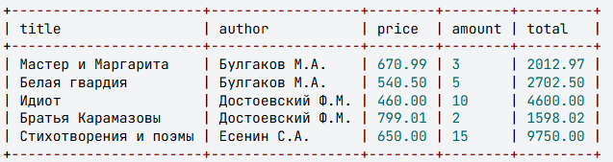
Selecting Data with a Calculated Column
SQL queries can perform calculations for each row of a table using a calculated column. This is specified in the field list after the SELECT operator by providing an expression and assigning it a name.
The expression can include:
Column names
Constants
Arithmetic operators
Built-in functions
The result is a table containing all data from the columns specified after SELECT, plus a new column where each row displays the computed value of the given expression.
Listener's note: You can perform arithmetic and logical calculations across an entire column, with the result being a new column.
Example
Display all information about books, and for each entry calculate its total value (price multiplied by quantity). Assign the name total to the calculated column.
SELECT title, author, price, amount, price * amount AS total FROM book;

Slide 6
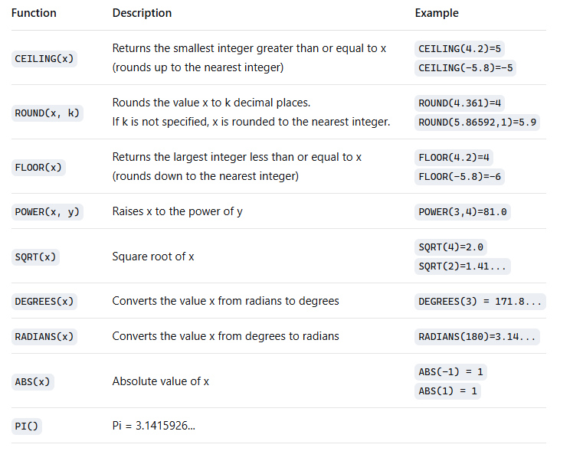
Selecting Data, Calculated Columns, Mathematical Functions
SQL implements numerous mathematical functions for working with numerical data. The table below lists some of them.
Explanation: There are different methods for rounding numbers. SQL implements mathematical rounding (round half up). To round a real number, you select the digit in the fractional part to which you are rounding. The digit in the selected position:
Remains unchanged if the digit immediately to its right is 0, 1, 2, 3, or 4.
Increases by one if the digit immediately to its right is 5, 6, 7, 8, or 9.

Slide 7
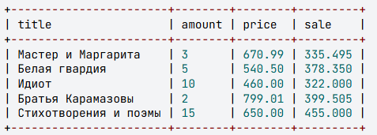
Selecting Data, Calculated Columns, Logical Functions
SQL provides the capability to assign a value to a field based on a condition. This is done using the IF() function:
IF(logical_expression, expression_1, expression_2)
The function evaluates the logical_expression. If it is TRUE, the field takes the value of expression_1; otherwise, it takes the value of expression_2. All three parameters of the IF() function are mandatory.
The use of nested functions is permitted, meaning a new IF function can be used in place of either expression_1 or expression_2.
Example
Let's set a discount for each book in the book table as follows: if the number of books is less than 4, the discount will be 50% of the price; otherwise, it will be 30%.
SELECT title, amount, price, IF(amount < 4, price * 0.5, price * 0.3) AS discount FROM book;

Slide 8

Selecting Data, Logical Operations
The logical expression following the WHERE keyword can include not only comparison operators and expressions but also logical operations (AND, OR, NOT) and parentheses, which change the order of operation precedence.
Order of Precedence:
Parentheses ()
Multiplication (*), Division (/)
Addition (+), Subtraction (-)
Comparison Operators (=, >, <, >=, <=, <>)
NOT
AND
OR
Example
Select the title, author, and price of books written by Bulgakov with a price greater than 600 rubles.
SELECT title, author, price
FROM book
WHERE author = 'Булгаков М.А.' AND price > 600;

Slide 9
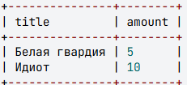
Selecting Data, BETWEEN and IN Operators
The logical expression following the WHERE keyword can include the BETWEEN and IN operators. The precedence of these operators is the same as that of the comparison operators, meaning they are executed before NOT, AND, and OR.
The BETWEEN operator allows you to select data within a certain range, including the boundary values.
Example
Select the titles and quantities of books whose quantity is between 5 and 14, inclusive.
SELECT title, amount
FROM book
WHERE amount BETWEEN 5 AND 14;
SELECT title, amount
FROM book
WHERE amount >= 5 AND amount <=14;

Slide 10
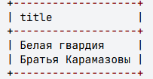
Selecting Data, the LIKE Operator
The LIKE operator is used to compare character strings. Unlike the equality (=) and inequality (<>) operators, LIKE allows for pattern matching instead of exact match comparison. The pattern can include regular characters and wildcard characters. During comparison, the regular characters in the pattern must exactly match the characters in the string. Wildcard characters can match arbitrary elements of the character string.
Example 1
Select the titles of books that start with the letter "Б".
SELECT title FROM book WHERE title LIKE 'Б%';
Wildcard | Description | Example
% | Matches any string of zero or more characters. | SELECT * FROM book WHERE author LIKE '%М.%' This searches for and returns all books where the author's initials contain "М."
_ (underscore) | Matches any single character. | SELECT * FROM book WHERE title LIKE 'Поэм_' This searches for and returns all books whose titles are "Поэма", "Поэмы", etc.

Slide 11
Selecting Data, the LIKE Operator
Example 2
Select the titles of books that consist of exactly 5 letters.

Slide 12
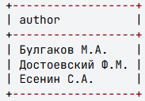
Selecting unique column elements
To select unique elements from a column, the DISTINCT keyword is used, which is placed right after SELECT.
Example
Select distinct authors whose books are stored in the book table.
SELECT DISTINCT author FROM book;
Another method is using the GROUP BY operator, which groups data during selection that have identical values in a specific column. The column used for grouping is specified after GROUP BY.
Using GROUP BY, you can select unique elements from the column used for grouping. The result will be exactly the same as when using DISTINCT.
SELECT author FROM book GROUP BY author;

Slide 13
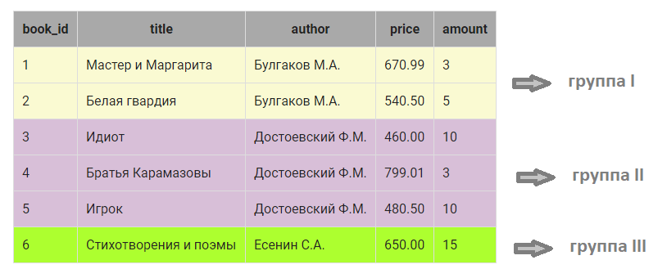
Data Retrieval, Aggregate Functions SUM and COUNT
When grouping, various operations can be performed on the column elements within each group, such as summing them up or counting the number of elements in the group.
Let's examine in detail how data grouping by a specific column and calculations on the group are performed using the following example:
SELECT author, sum(amount), count(amount) FROM book GROUP BY author;
1. Rows with identical values in the author column are identified in the book table:
Three distinct groups are formed:
Group I combines two entries with the value Булгаков М.А. in the author column.
Group II combines three entries with the value Достоевский Ф.М. in the author column.
Group III combines one entry with the value Есенин С.А. in the author column.

Slide 14
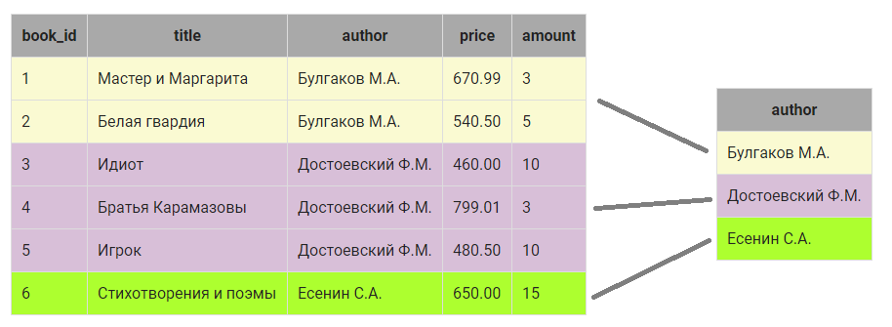
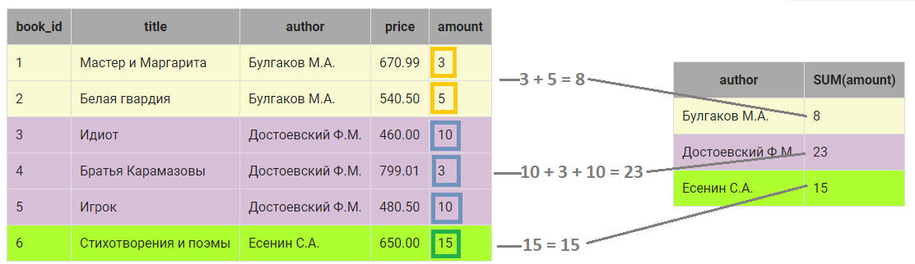
Data Retrieval, Aggregate Functions SUM and COUNT
2. Instead of each group, a single record is included in the result set. This record includes at least the value of the column used for grouping (in our case, author):
3. Next, calculations can be performed on the elements of EACH group individually, for example, calculating the total number of book copies for each author. For this, the aggregate function SUM() is used, and the column to be summed is specified in parentheses (in our case, amount):

Slide 15
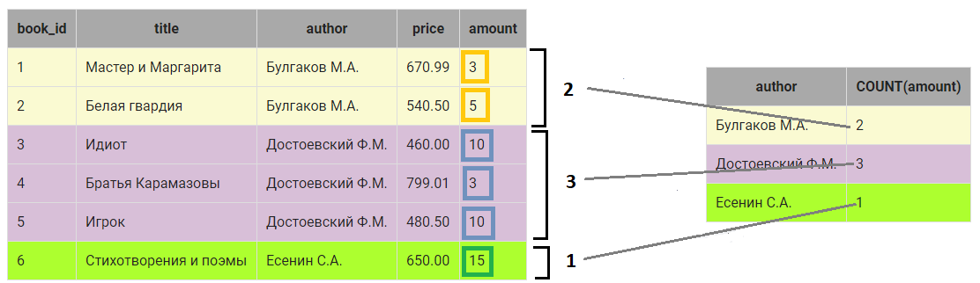
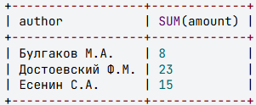
Data Retrieval, Aggregate Functions SUM and COUNT
You can also count how many records belong to a group. For this, the COUNT() function is used. You can specify ANY column from the group in parentheses, provided the group contains no empty values (an example is provided below showing how COUNT() works if there are empty values in the group):
Example
Calculate how many copies of books by each author are stored in the warehouse.
SELECT author, SUM(amount) FROM book GROUP BY author;

Slide 16
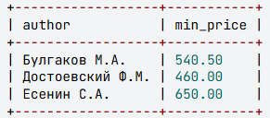
Data Retrieval, Aggregate Functions MIN, MAX and AVG
SQL aggregate functions include: MIN(), MAX() and AVG(), which calculate the minimum, maximum, and average values of the column elements belonging to a group.
Example
Display the minimum price for each author's books.
SELECT author, MIN(price) AS min_price FROM book GROUP BY author;

Slide 17
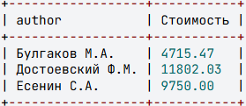
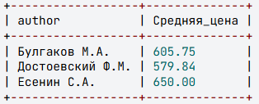
Data Retrieval with Calculation, Aggregate Functions
The argument for SQL aggregate functions can be not only a column, but any valid SQL arithmetic expression.
Example
Display the total cost of books for each author.
SELECT author, SUM(price * amount) AS Стоимость
FROM book
GROUP BY author;
Aggregate functions can be part of expressions. For example, when calculating the average cost of books for each author in the previous step, values with six decimal places were obtained. Since this represents money, the values need to be rounded to 2 decimal places.
Example2
Find the average price of books for each author.
SELECT author, ROUND(AVG(price),2) AS Средняя_цена
FROM book
GROUP BY author;

Slide 18


Calculations on the Entire Table
Aggregate functions allow you to calculate summary values for the entire table. For example, you can calculate the total number of books in the warehouse, compute the total cost, etc. To do this, the aggregate function for an expression or column name is specified after the SELECT keyword, and the GROUP BY clause is omitted.
Example
Calculate the total number of book copies in the warehouse.
SELECT SUM(amount) AS Количество
FROM book;
Example
Calculate the total number of book copies in the warehouse.
SELECT SUM(amount) AS Количество,
SUM(price * amount) AS Стоимость
FROM book;

Slide 19
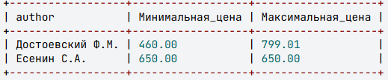
Data Retrieval with Conditions, Aggregate Functions
Conditions for filtering rows, which are specified after WHERE in regular queries, can be included in queries with aggregate functions. In queries with aggregate functions, the HAVING keyword is used instead of WHERE, and it is placed after the GROUP BY clause.
Example
Find the minimum and maximum price of books for all authors whose total book cost is greater than 5000.
SELECT author,
MIN(price) AS Минимальная_цена,
MAX(price) AS Максимальная_цена
FROM book
GROUP BY author
HAVING SUM(price * amount) > 5000;

Slide 20
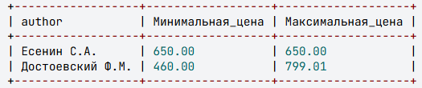
Data Retrieval with Conditions, Aggregate Functions
Data in grouped queries can also be sorted.
Example2
Find the minimum and maximum price of books for all authors whose total book cost exceeds 5000. Display the result in descending order of the minimum price.
SELECT author,
MIN(price) AS Минимальная_цена,
MAX(price) AS Максимальная_цена
FROM book
GROUP BY author
HAVING SUM(price * amount) > 5000
ORDER BY Минимальная_цена DESC;

Slide 21

Data Retrieval with Conditions, Aggregate Functions, WHERE and HAVING
WHERE and HAVING can be used in the same query. However, it is important to consider the order of execution of the SQL SELECT query on the SERVER:
FROM
WHERE
GROUP BY
HAVING
SELECT
ORDER BY
First, the table from which data is retrieved is determined (FROM). Then, records are filtered according to the condition in WHERE. The filtered data is aggregated (GROUP BY), and from the aggregated records, those satisfying the condition after HAVING are selected. Next, the resulting dataset is formed as specified after SELECT (expressions are calculated, names are assigned, etc.). Finally, the resulting dataset is sorted as specified after ORDER BY.
Important! The order of EXECUTION of queries is not the same as the order of WRITING keywords in the SELECT query. The written order (query syntax) remains the same as previously discussed in the course. The EXECUTION ORDER is necessary to understand why, for example, you cannot use expression names from SELECT in WHERE. This is simply because SELECT is executed by the compiler later than WHERE, so it is unaware of the expressions written in SELECT at that stage.
SELECT author,
MIN(price) AS Минимальная_цена,
MAX(price) AS Максимальная_цена
FROM book
WHERE author <> 'Есенин С.А.'
GROUP BY author
HAVING SUM(amount) > 10;

Slide 22
Nested Queries
SQL allows the creation of nested queries. A nested query (subquery, inner query) is a query inside another SQL query.
A nested query is used to retrieve data that will be used in the selection condition of the main query. It is applied for:
Comparing an expression with the result of a nested query;
Determining whether an expression is included in the results of a nested query;
Checking if the query selects certain rows.
A nested query consists of the following components:
The SELECT keyword followed by column names or expressions (most often the list contains one element);
The FROM keyword and the name of the table from which data is selected;
An optional WHERE clause;
An optional GROUP BY clause;
An optional HAVING clause.
Nested queries can be included in WHERE or HAVING as follows (optional elements are indicated in square brackets, and | denotes one of the elements):
WHERE | HAVING expression comparison_operator (subquery);
WHERE | HAVING expression including a subquery;
WHERE | HAVING expression [NOT] IN (subquery);
WHERE | HAVING expression comparison_operator ANY | ALL (subquery).

Slide 23

Subquery Returning a Single Value
A subquery that returns a single value can be used in the WHERE clause as a regular value with the operators =, <>, >=, <=, >, <.
Example
Display information about the cheapest books stored in the warehouse.
To implement this query, we need to obtain the minimum price from the price column of the book table, and then display information about the books whose price equals this minimum. The first part — finding the minimum — is implemented using a subquery.
SELECT title, author, price, amount
FROM book
WHERE price = (
SELECT MIN(price)
FROM book
);

Slide 24
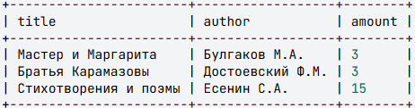
Using a Subquery in an Expression
A subquery that returns a single value can be used in expressions as a regular operand. For example, you can add to it, subtract from it, etc.
Example
Display information about books whose number of copies differs from the average number of book copies in the warehouse by more than 3. That is, you need to display books whose number of copies is either 3 less than the average or 3 more than the average.
SELECT title, author, amount
FROM book
WHERE ABS(amount - (SELECT AVG(amount) FROM book)) >3;

Slide 25
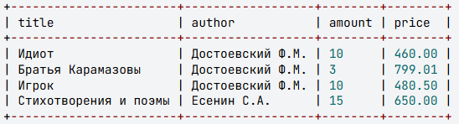
Subquery with the IN Operator
A subquery can return multiple values from a single column. In this case, it can be used in the WHERE clause with the IN operator.
WHERE column_name IN (subquery returning one column)
The IN operator checks whether the value of a column matches one of the values returned by the subquery. If it does, the logical expression in the WHERE clause evaluates to true. The NOT IN operator performs the opposite action—the expression is true if the column value is not present in the subquery results.
Example
Display information about books by authors whose total number of book copies is at least 12.
SELECT title, author, amount, price
FROM book
WHERE author IN (
SELECT author
FROM book
GROUP BY author
HAVING SUM(amount) >= 12
);

Slide 26
Subquery with the IN Operator
A subquery can return multiple values from a single column. In this case, it can be used in the WHERE clause with the IN operator.
WHERE column_name IN (subquery returning one column)
The IN operator checks whether the value of a column matches one of the values returned by the subquery. If it does, the logical expression in the WHERE clause evaluates to true. The NOT IN operator performs the opposite action—the expression is true if the column value is not present in the subquery results.
Example
Display information about books by authors whose total number of book copies is at least 12.
SELECT title, author, amount, price
FROM book
WHERE author IN (
SELECT author
FROM book
GROUP BY author
HAVING SUM(amount) >= 12
);

Slide 27

A subquery that returns a single value
A subquery that returns a single value can be used in the WHERE clause record selection condition as a regular value alongside the operators =, <>, >=, <=, >, <.
Example
Retrieve information about the cheapest books stored in the warehouse.
To implement this query, we need to obtain the minimum price from the price column of the book table, and then display information about those books whose price equals the minimum. The first part – finding the minimum – is implemented by a subquery.
SELECT title, author, price, amount
FROM book
WHERE price = (
SELECT MIN(price)
FROM book
);

Slide 28
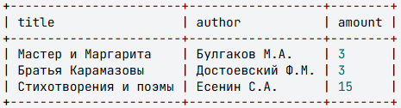
Using a subquery in an expression
A subquery that returns a single value can be used in expressions as a regular operand. For example, you can add to it, subtract from it, etc.
Example
Retrieve information about books whose number of copies differs from the average number of book copies in the warehouse by more than 3. That is, we need to list both books whose number of copies is 3 less than the average and those whose number of copies is 3 more than the average.
SELECT title, author, amount
FROM book
WHERE ABS(amount - (
SELECT AVG(amount)
FROM book)
) >3;

Slide 29
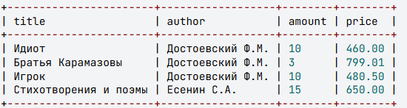
Subquery, IN operator
A subquery can return multiple values from a single column. In this case, it can be used in the WHERE clause with the IN operator.
WHERE column_name IN (subquery returning a single column)
The IN operator checks whether the column value matches one of the values contained in the subquery. When it does, the logical expression after WHERE evaluates to true. The NOT IN operator performs the reverse action - the expression is true if the column value is not contained in the subquery.
Example
Display information about books by authors whose total number of book copies is at least 12.
SELECT title, author, amount, price
FROM book
WHERE author IN (
SELECT author
FROM book
GROUP BY author
HAVING SUM(amount) >= 12
);
The subquery selects two authors (Dostoevsky and Esenin). Then, in the main query, for each record in the book table, it checks whether the book's author is included in the selected list. If it is, the book's information is included in the result set.

Slide 30
Subqueries, ANY and ALL operators
A subquery that returns multiple values from a single column can be used to filter records using the ANY and ALL operators in conjunction with comparison operators (=, <>, <=, >=, <, >).
The ANY and ALL operators in SQL are used to compare a value with the result set of a subquery, which consists of a single column. The data type of the column returned by the subquery must match the data type of the column (or expression) being compared.
When using the ANY operator, all records for which the comparison expression is true for at least one element of the subquery result set will be included in the final result. How the ANY operator works:
amount > ANY (10, 12) is equivalent to amount > 10
amount < ANY (10, 12) is equivalent to amount < 12
amount = ANY (10, 12) is equivalent to (amount = 10) OR (amount = 12), and also to amount IN (10,12)
amount <> ANY (10, 12) will return all records with any value of amount, including 10 and 12.
When using the ALL operator, all records for which the comparison expression is true for all elements of the subquery result set will be included in the final result. How the ALL operator works:
amount > ALL (10, 12) is equivalent to amount > 12
amount < ALL (10, 12) is equivalent to amount < 10
amount = ALL (10, 12) will not return any records, as it is equivalent to (amount = 10) AND (amount = 12)
amount <> ALL (10, 12) will return all records except those where amount is 10 or 12.
Important! The ALL and ANY operators can only be used with subqueries. In the examples above, (10, 12) is shown as the result of a subquery simply to demonstrate how these operators work. This syntax cannot be used directly in queries.
Example
Retrieve information about books whose quantity is less than the smallest average number of books per author.

Slide 31
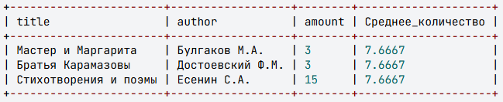
Subquery in the SELECT clause
A subquery can be placed after the SELECT keyword. In this case, the result of the subquery is displayed in a separate column of the result table. For this to work correctly, the subquery must return a single value, which will then be repeated in every row. The subquery can also be used within expressions.
Example
Retrieve information about books whose number of copies differs from the average number of book copies in the warehouse by more than 3, and also show the average value of the number of book copies.
SELECT title, author, amount, (
SELECT AVG(amount)
FROM book
) AS Среднее_количество
FROM book
WHERE abs(amount - (
SELECT AVG(amount)
FROM book)
) >3;

Slide 32
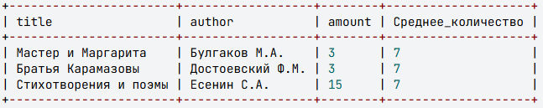
Subquery in the SELECT clause
The subquery calculates the average number of book copies in the warehouse. This subquery is used both in the selection condition and to create the "Average_Quantity" column in the query's result table. The values in this column are the same across all rows since the subquery returns a single value.
The average quantity displayed as a fractional number doesn't look quite right. The resulting value can be rounded "down" - to the nearest lower integer.
SELECT title, author, amount,
FLOOR((SELECT AVG(amount) FROM book)) AS Среднее_количество
FROM book
WHERE ABS(amount - (SELECT AVG(amount) FROM book)) >3;

